Slide 1
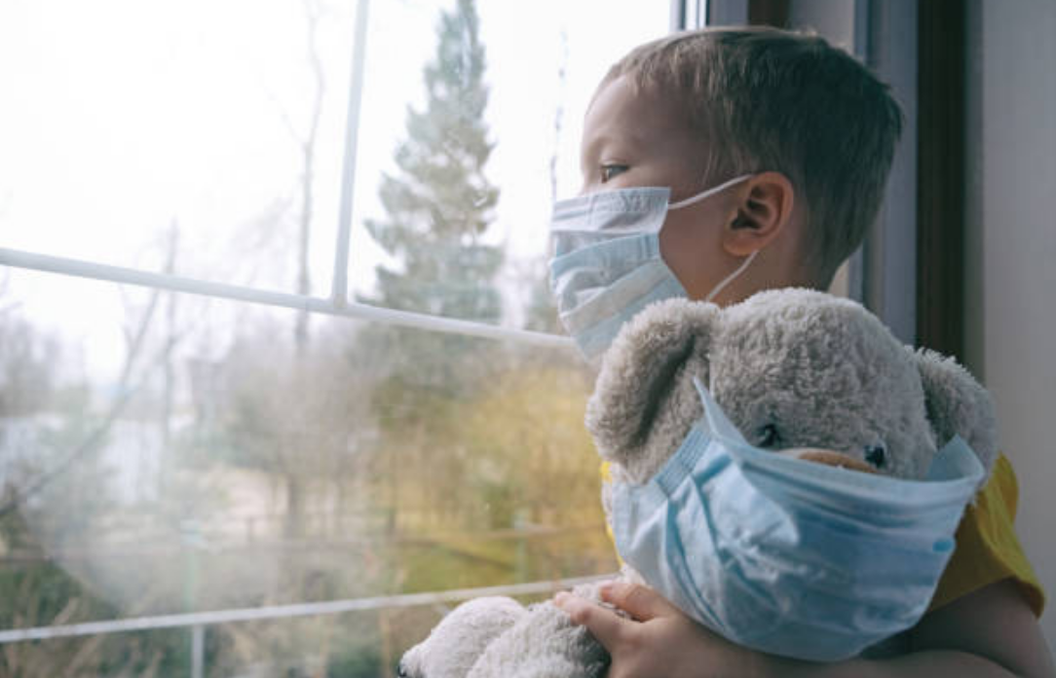
Call for Code Hackathon 2020
Covid-19 Fighter Assistant
-This document is created by Pratyaya Mondal keeping the current global pandemic situation in mind to provide a community cooperation.

Slide 2
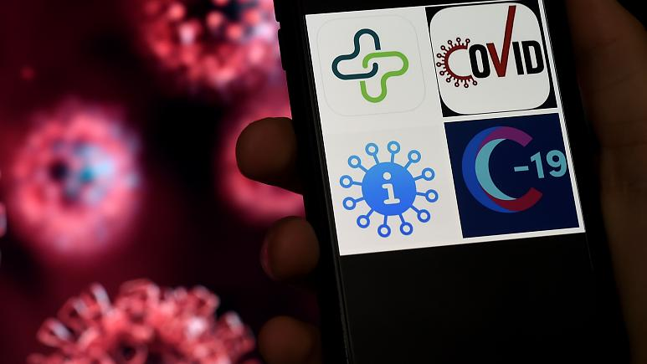
Introduction
Team Name : Covid-19 Fighter Assistant
Team Members : Pratyaya Mondal

Slide 3
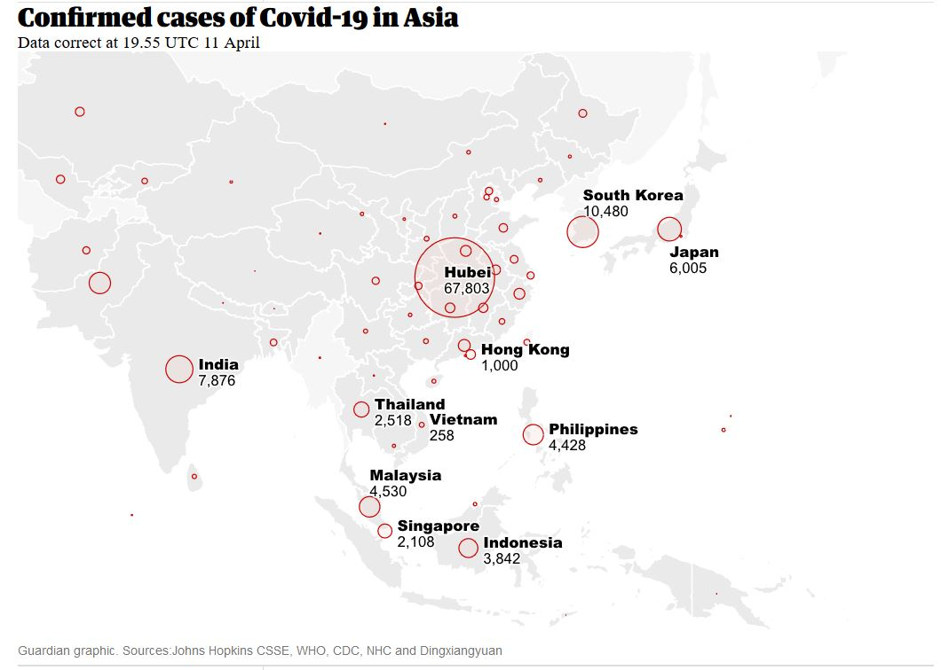
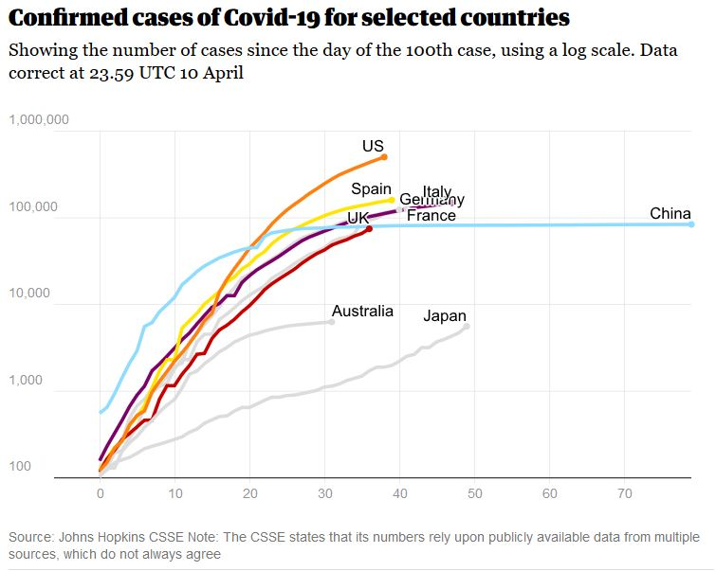
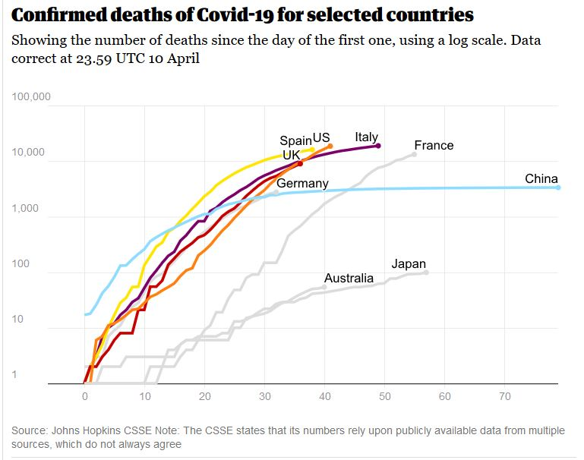
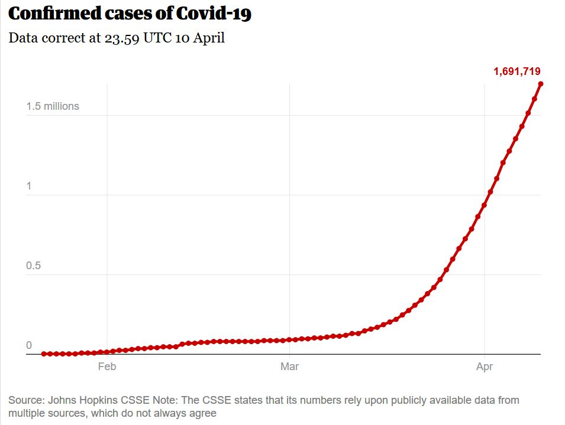
Problem Statement
Coronavirus disease (COVID-19) is an infectious disease caused by a new virus. The disease causes respiratory illness (like the flu) with symptoms such as a cough, fever, and in more severe cases, difficulty breathing. You can protect yourself by washing your hands frequently, avoiding touching your face, and avoiding close contact (1 meter or 3 feet) with people who are unwell.
“We are at a critical point in the global response to COVID-19 – we need everyone to get involved in this massive effort to keep the world safe.” _ Dr. Tedros Adhanom Ghebreyesus
It is important to know and predict the spread of CORONA Virus for the administrative service provider and hospitals to keep the medical support for diseased ready and available on time.
As of last week, 114 countries have reported that 118,000 have contracted Covid-19, the disease caused by the virus, known as SARS-CoV2. Nearly 4,300 people have died.
In the United States, where for weeks state and local laboratories could not test for the virus, just over 1,000 cases have been diagnosed and 29 people have died. But authorities here warn continuing limits on testing mean the full scale of spread in this country is not yet known.

Slide 4
Solution
Fight COVID-19 : Predict Better to Plan Better
This is a predictive model and analytical tool that helps predicting the growth and spread of the virus. Helps both considering and deciding the lockdown period and the span.
To add, once the impacted areas are identified, immediately workforce could be sent.
Once an organizational body can predict the spread of the pandemic situation, it is always useful and better planned. This is more profitable in terms of disaster management than a financial benefit.
However, in broader sense mitigating and meeting the need on time in case of pandemic situation will help preserving global financial status.
As of April 11, 2020, there had been cases of the disease in around 210 countries or territories across 6 continents. China was initially the country most impacted by the disease, however the United States, Spain, Italy, Germany, and France now have the most cases worldwide. As of this time, there had been a total of 1,699,676 cases of COVID-19 worldwide, with 502,876 of these cases found in the United States and 81,953 found in China. Many countries around the world are now enforcing lockdowns to try to slow the spread of the disease. Such measures and restrictions vary from country to country but usually involve closing schools, canceling public events, closing borders, and encouraging people to work from home.

Slide 5
Business Model
This tool can be implemented on a cloud based application portal using multiple APIs to pull reliable data from various sources and feed them back with the prediction. We can sell the tool as a SAAS to the clients/users.
This could be projected as an industry solution to the disaster management organizations and hospitals to track and plan better to handle the pandemic situation.
As a part of community cooperation this tool can also be used. And given enough data feed this could also identify and highlight the areas on a map, for better understanding of the hotspot areas. And on a mathematical model it could also help calculating the lockdown span required based on the current scenario to reach the diseased at a baseline.
Disaster management organization, government bodies or hospitals can more accurately invest and plan their need on the pandemic situations. (it is always good to be ready with more strength but that might require huge investment, this model will help the situation to identify the required strength of accommodation).
Depending upon the spread of the disease and the financial condition of the nation accurately predicting the number could save million of lives and huge amount of money and national resources. This could also be used on medicine suppliers end so that they could maintain the required medicines on time to fight against the COVID-19.
To implement the fully functional system it might cost 3 people to work for 2 months but could save a lot of money and human resources throughout the world.

Slide 6


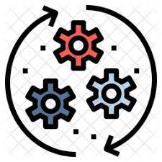




Demo, Explain how it Works
Implement to the community and Resampling
AI based Engine
Implementation on cloud based application
APIs for data acceptance and feedback
The ides behind this model is to capture data from different online sources via APIs and process them in a machine learning AI engine. We take the engine to the online or could based web application which will be accessed and feed the online service providers. We take the decision based upon the output of the AI model and implement. Resampling is done of the implemented model and outcome from the behavior and by monitoring the spread on a real time basis.

Slide 7
Summarize and Thank You
The Fighter Assistant provides ability to access and get data from multiple sources , ability to make decision by means of machine learning technologies, time series analysis and mathematical model to assist governing bodies to provide support in decision making, forecasting and budget allocation planning's. Keeping COVID-19 situation in mind it can be used to identify and mark impacted areas on map, and helps measuring the lockdown span based on the rate of spread.
When implemented this will grow to a cloud based application with full automation and processing real time data from web.

Slide 8
Thank you

